Slide 1
Visualizing data
Data Studio • The Lede Program • Columbia University
Hilary Fung • Monday, July 15, 2019

Slide 2
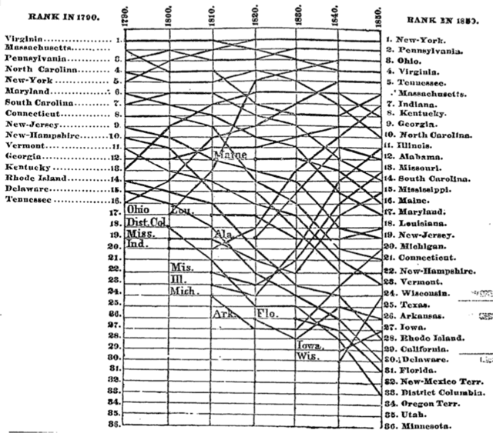

Slide 3
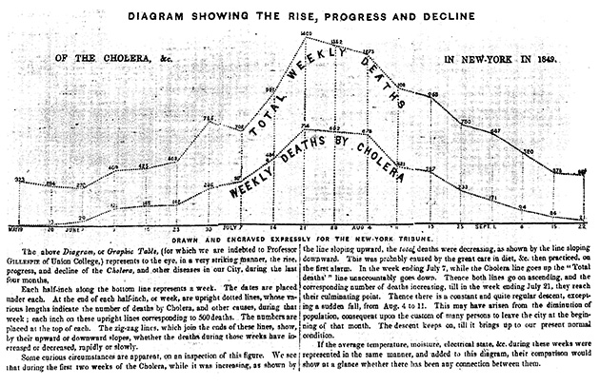
The New York Tribune, Sept. 29, 1849

Slide 4


Slide 5


Slide 6
Pies and bars

Slide 7
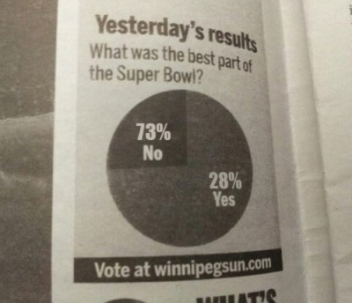
kodiakkb on I Love Charts

Slide 8
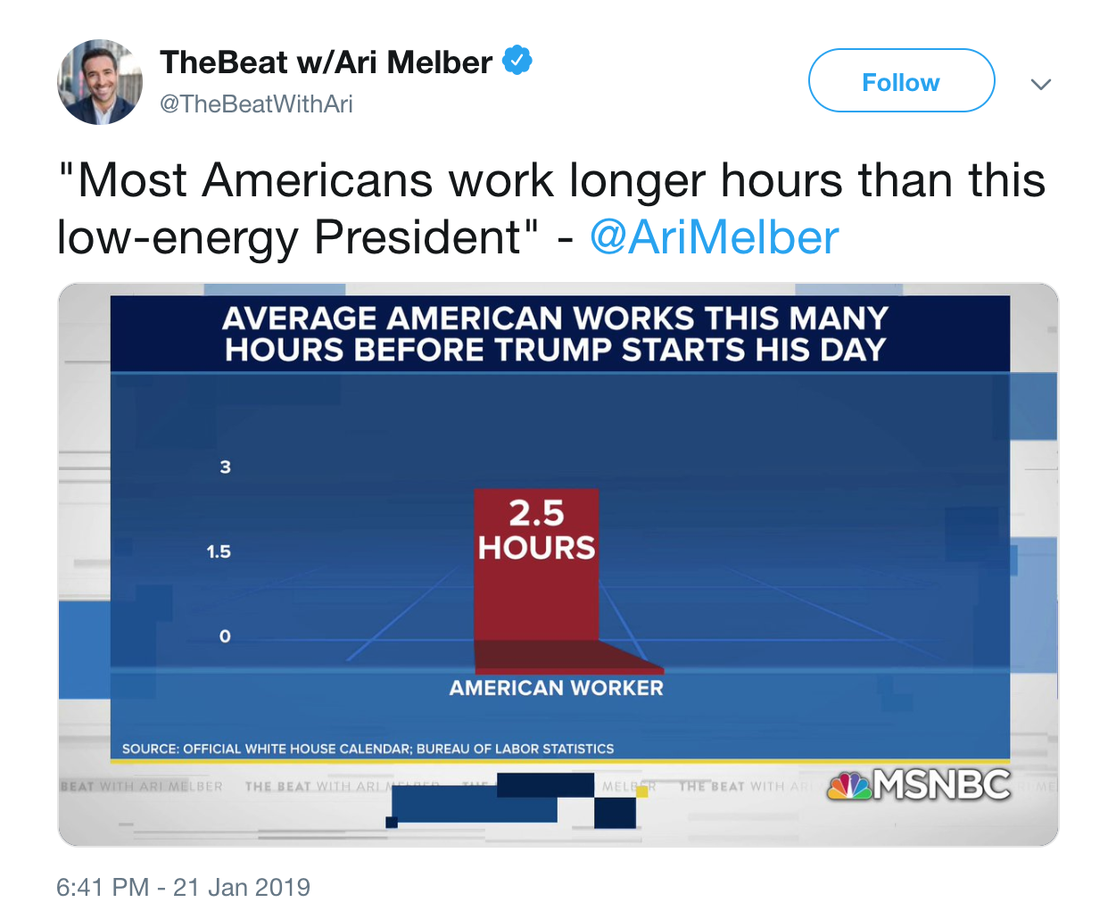

Slide 9
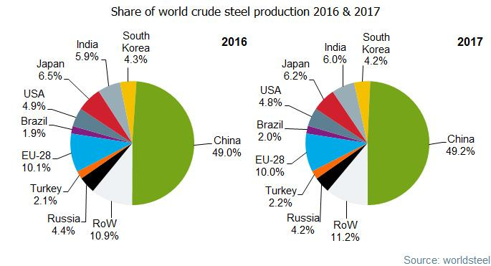

Slide 10
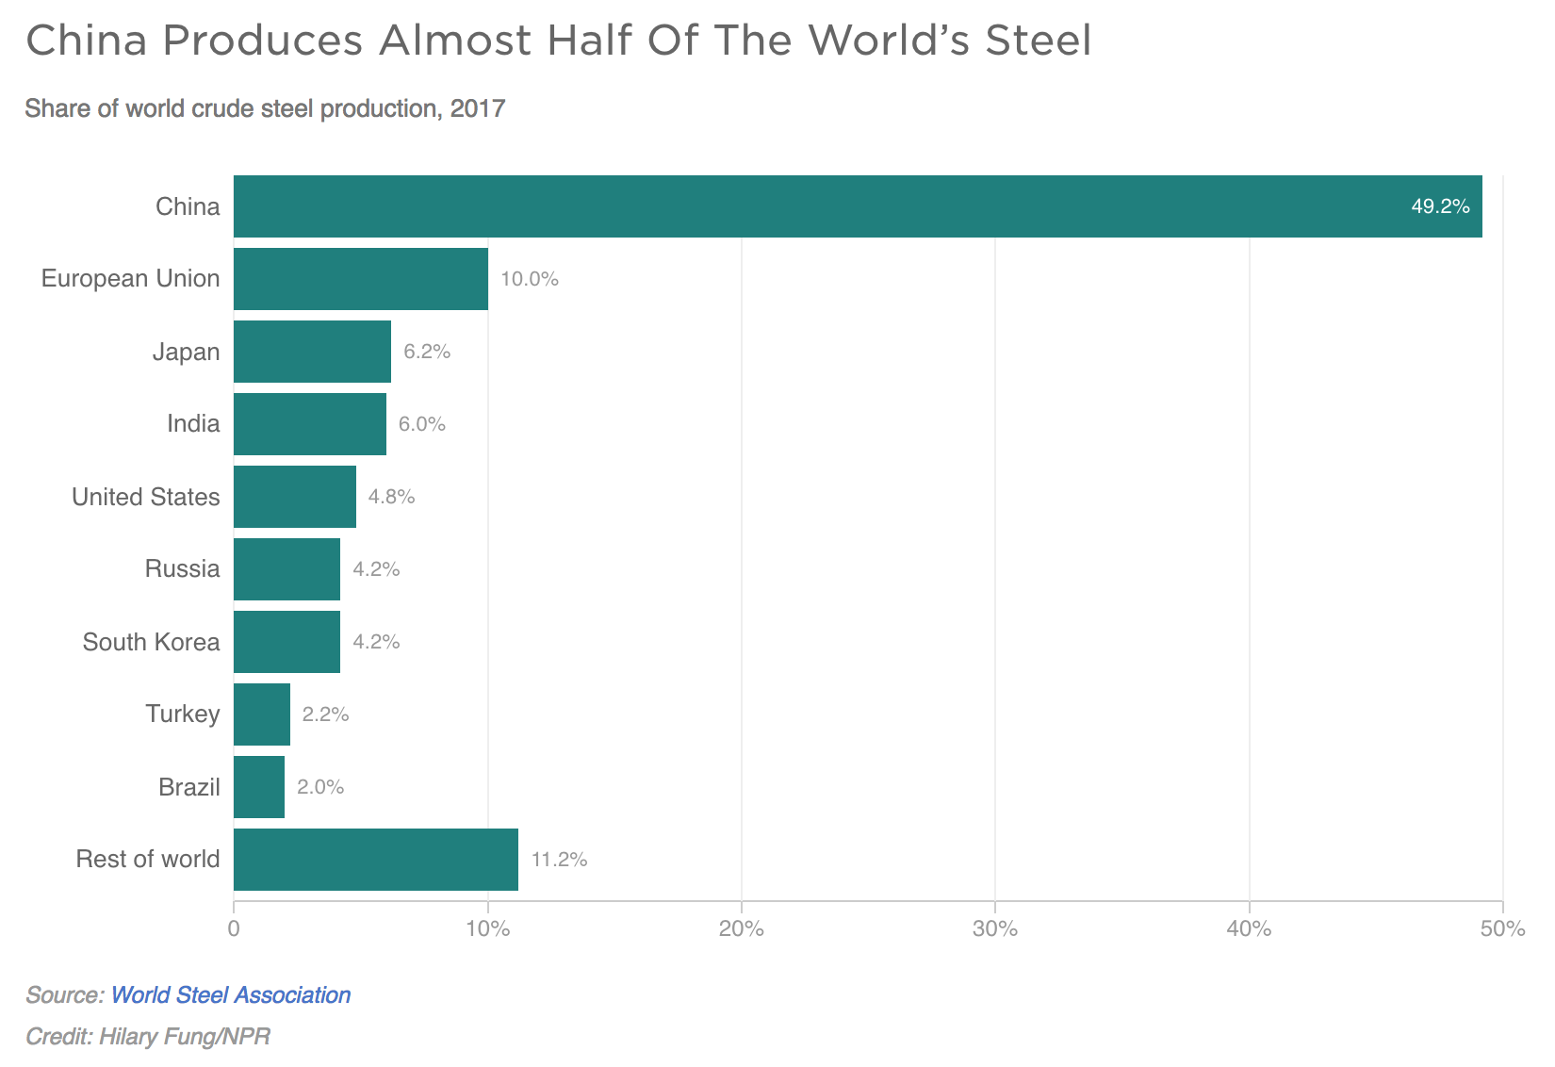

Slide 11
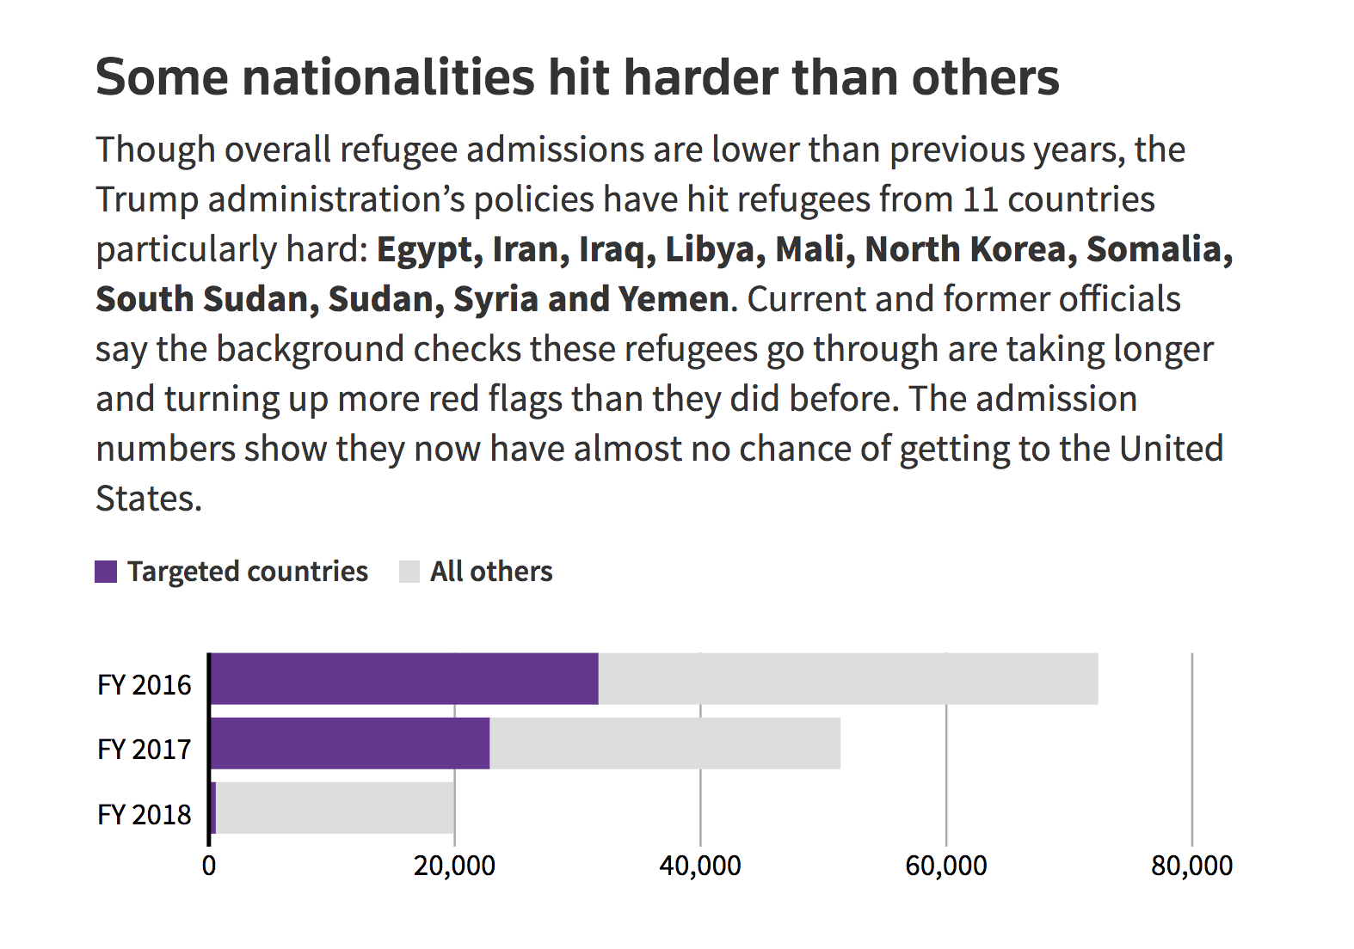

Slide 12
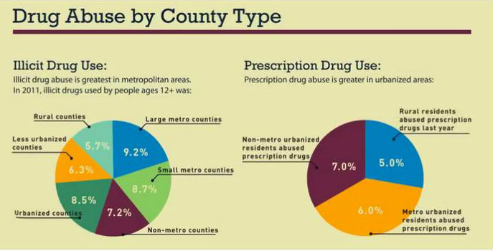

Slide 13
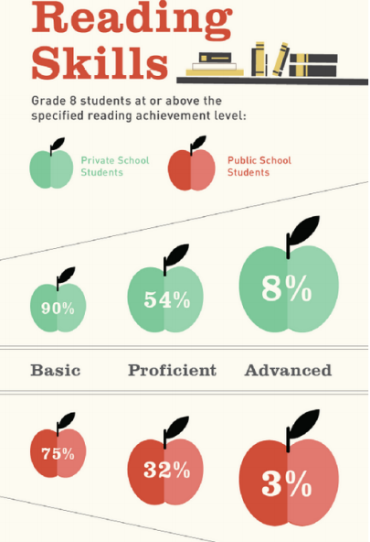
Quarry Lane Blog

Slide 14
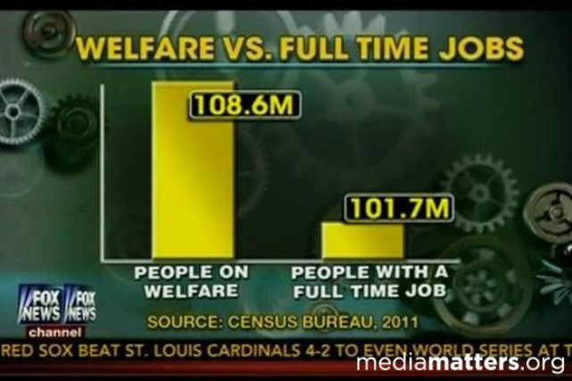
Fox News via mediamatters.org

Slide 15
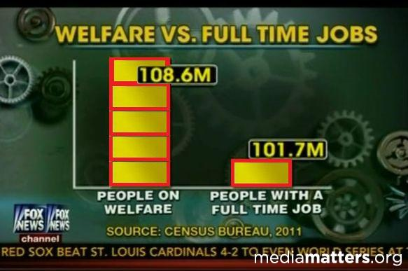

Slide 16
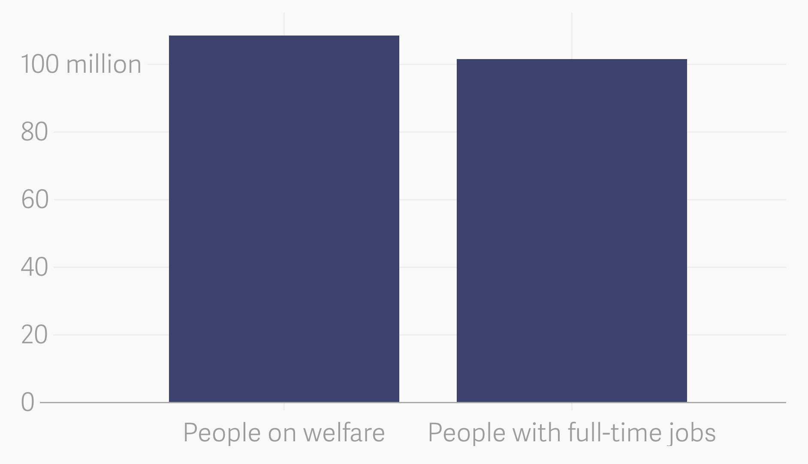

Slide 17
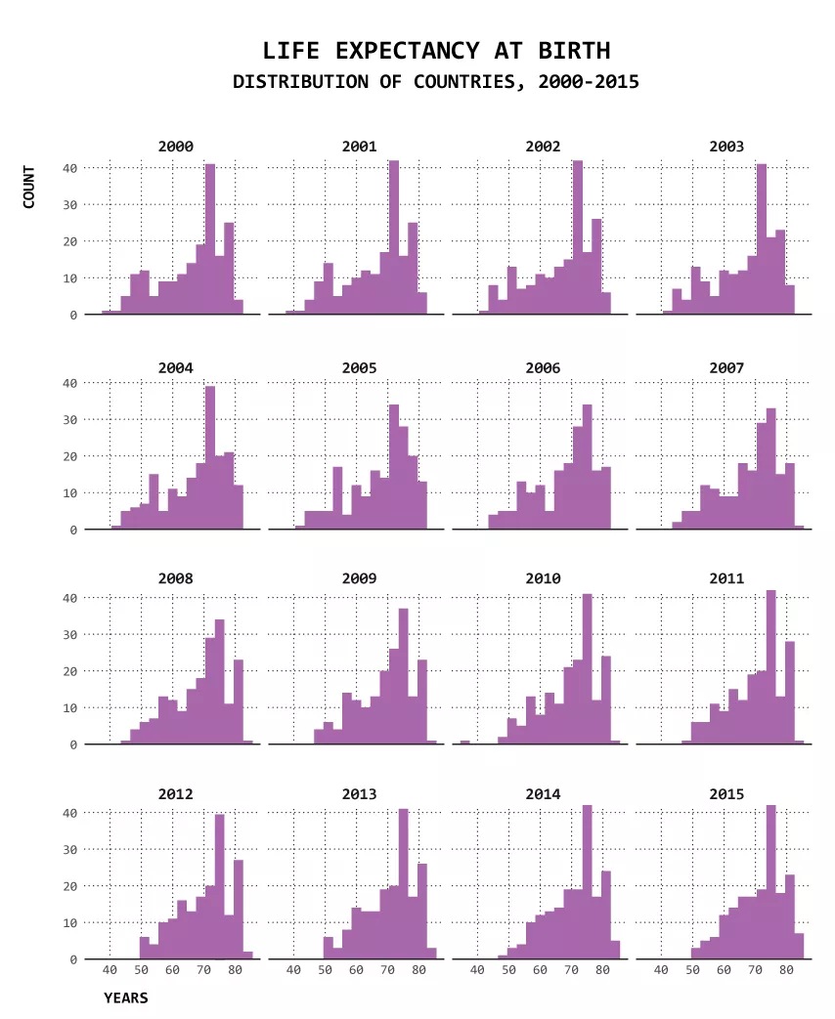
Histogram

Slide 18
Line charts and area charts

Slide 19
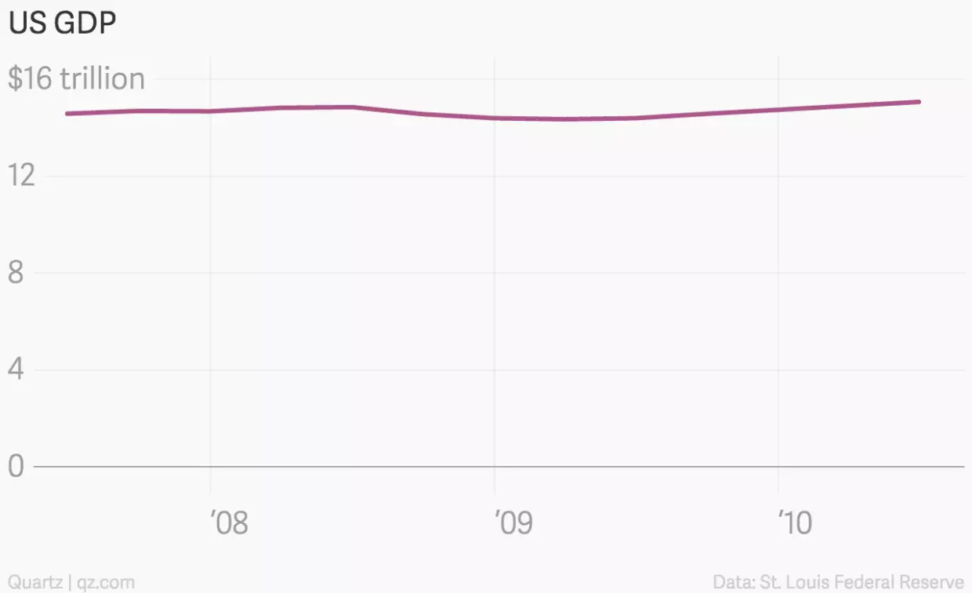

Slide 20
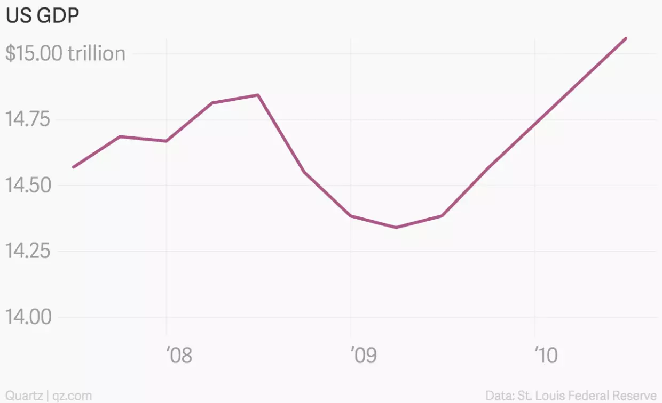

Slide 21
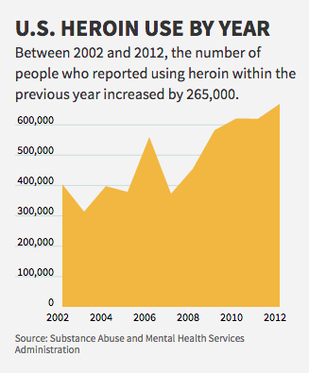
The Huffington Post

Slide 22
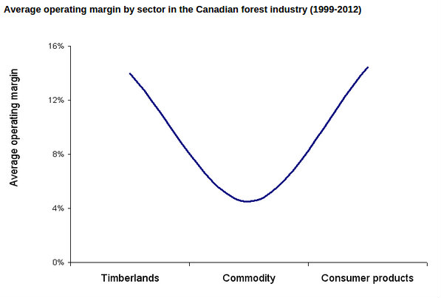
Natural Resources Canada

Slide 23
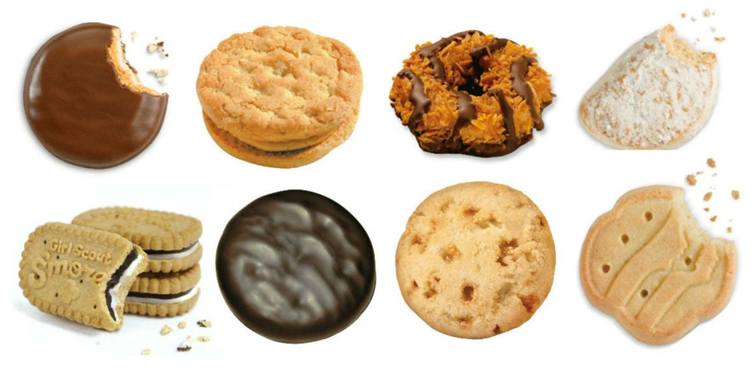
QUALITATIVE:
Tagalongs
Do-si-dos
Samoas
Savannah Smiles
S’mores
Thin Mints
Toffe-tastic
Trefoils

Slide 24
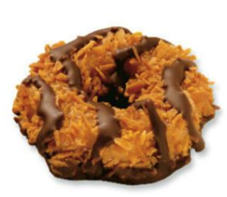
QUANTITATIVE

Slide 25
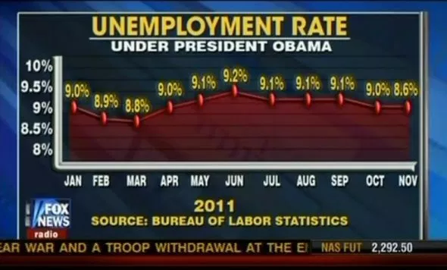

Slide 26
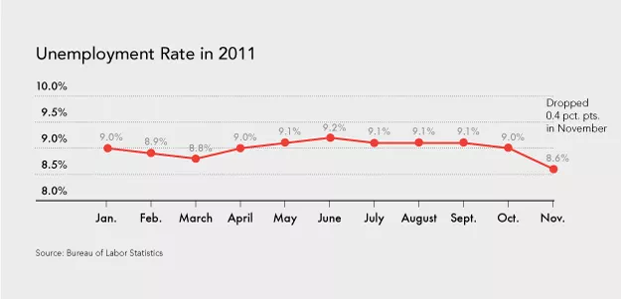

Slide 27
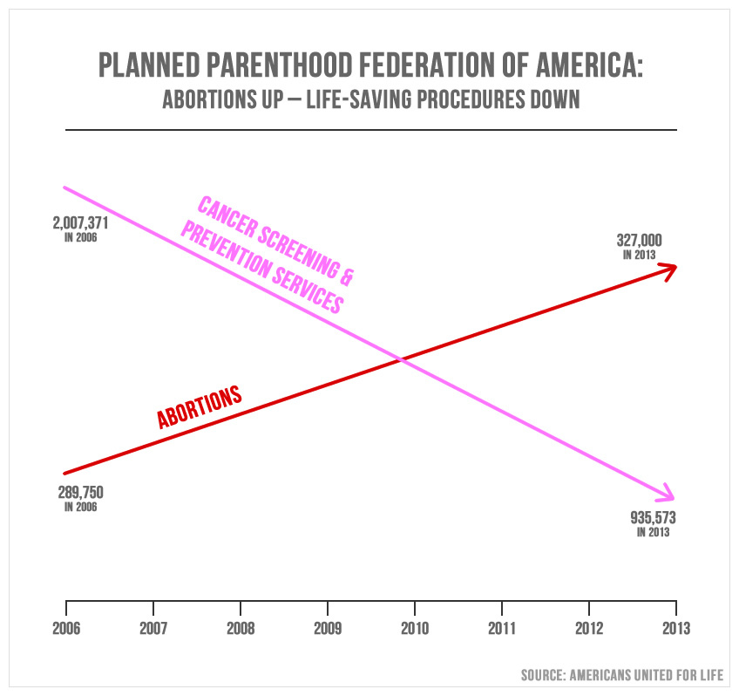

Slide 28
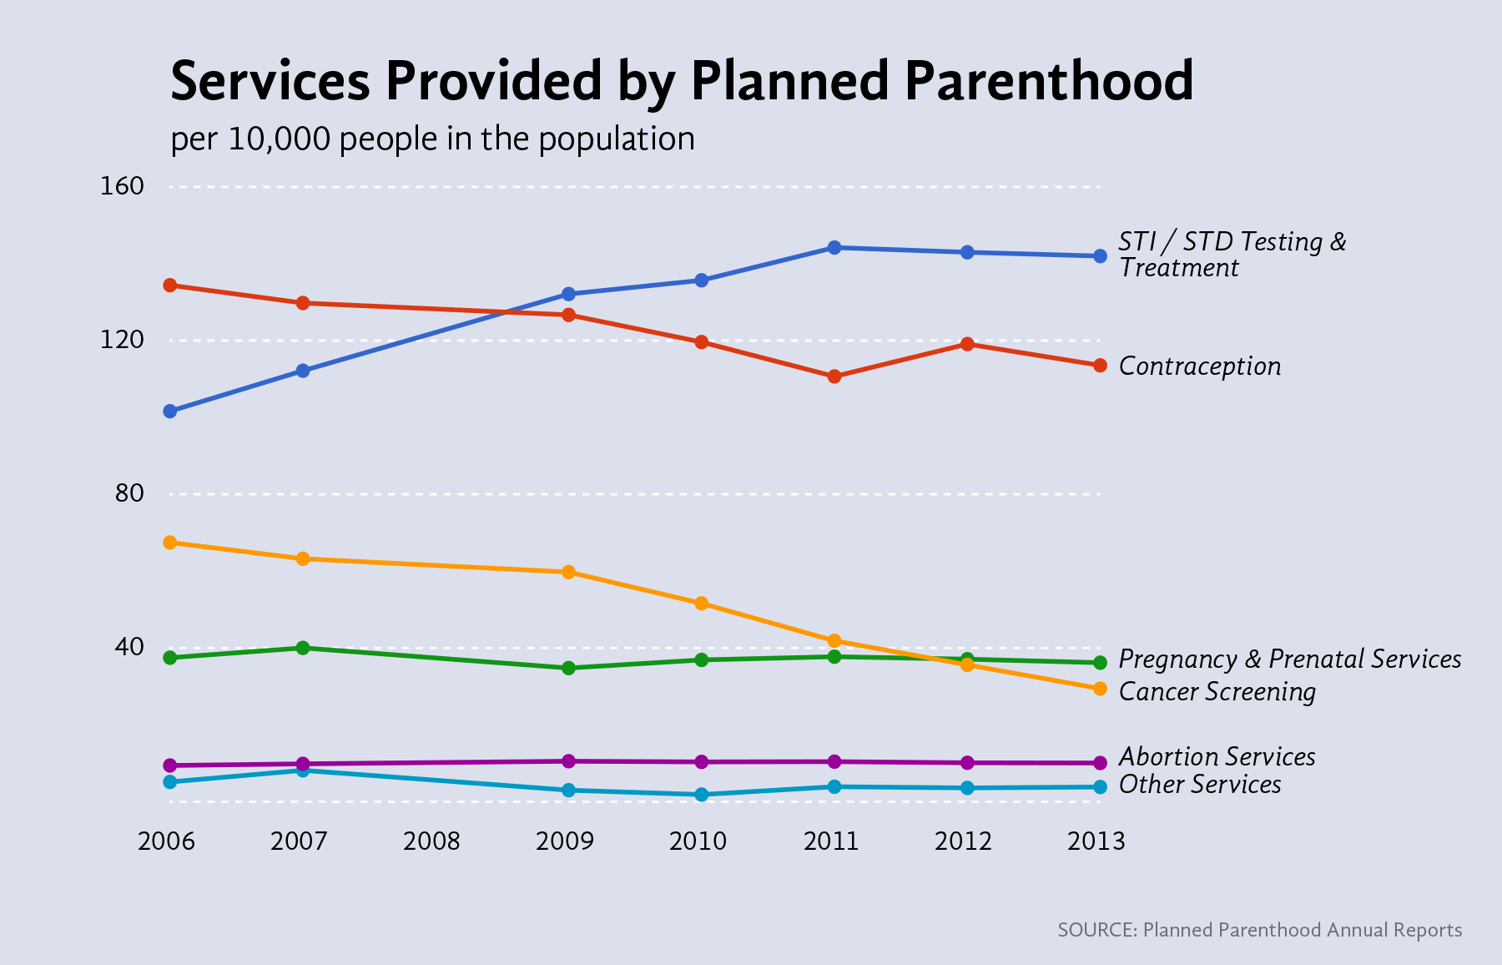

Slide 29


Slide 30
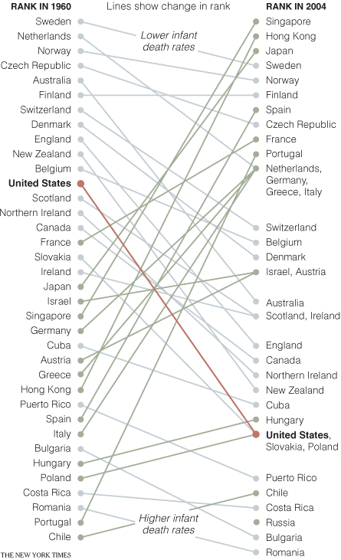

Slide 31
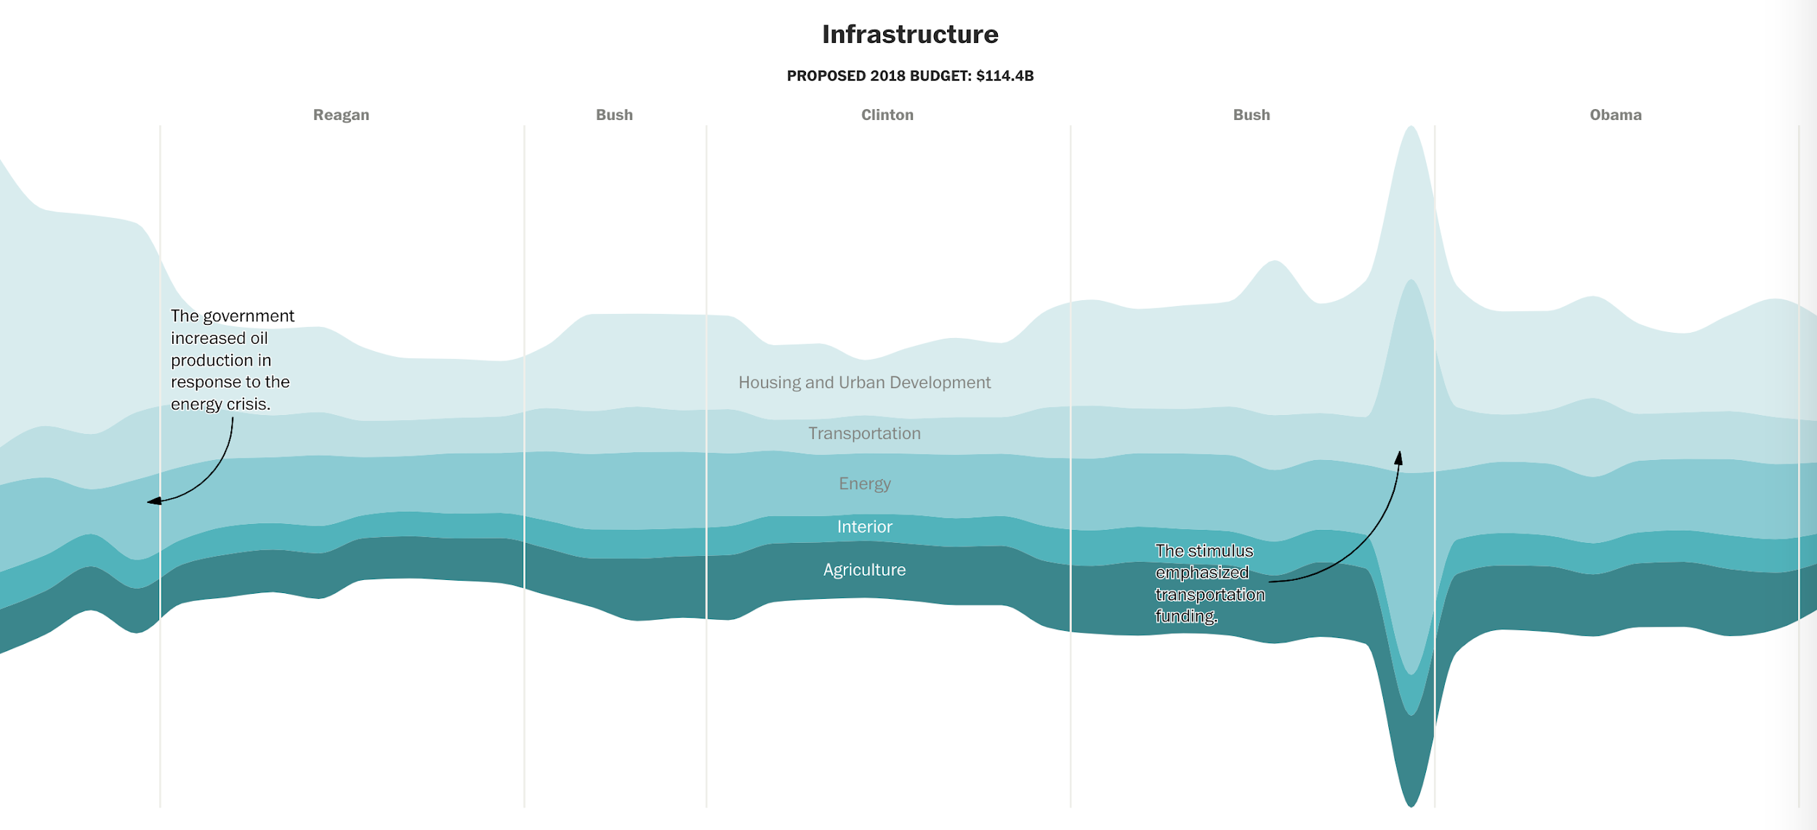

Slide 32
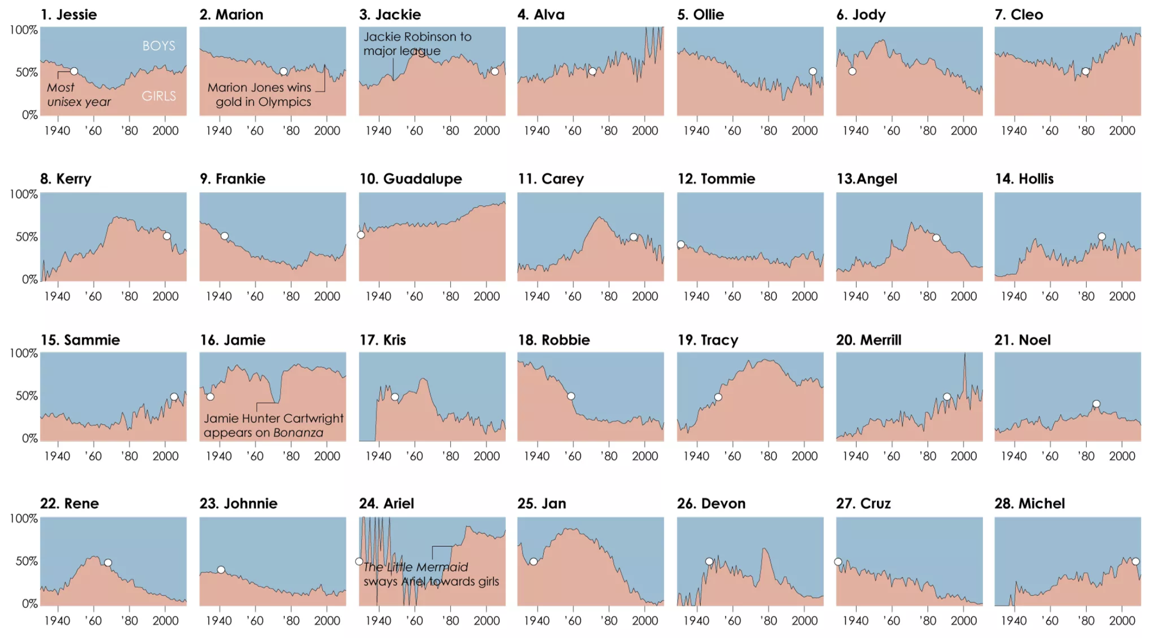

Slide 33
Venn diagrams

Slide 34
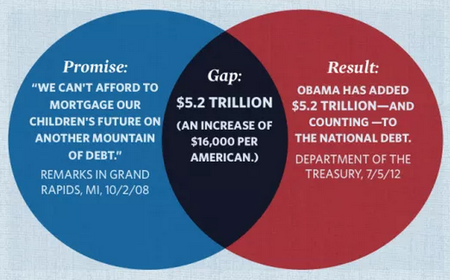
Mitt Romney via FlowingData

Slide 35
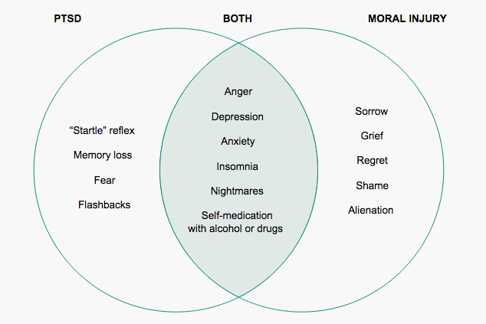
Huffington Post

Slide 36
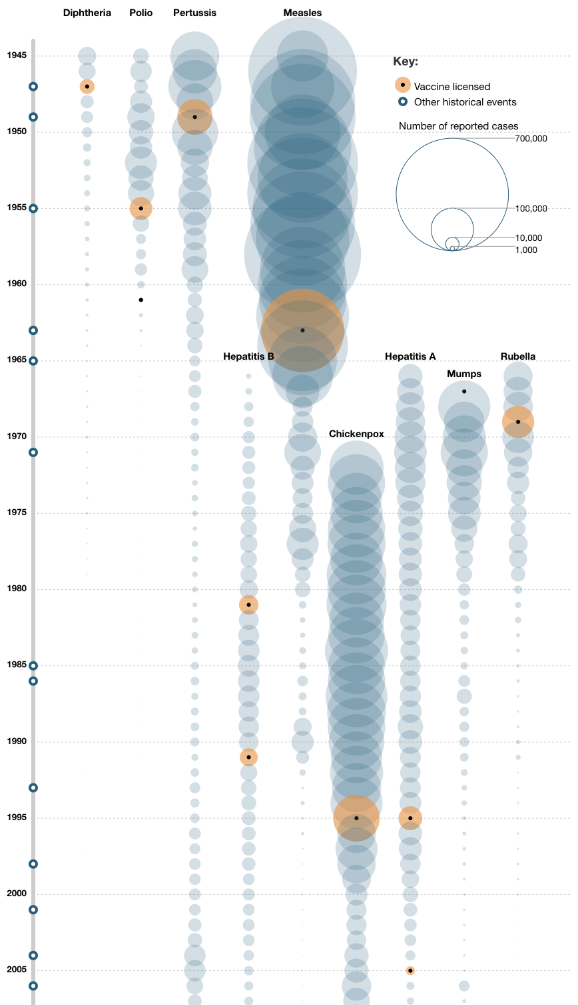

Slide 37
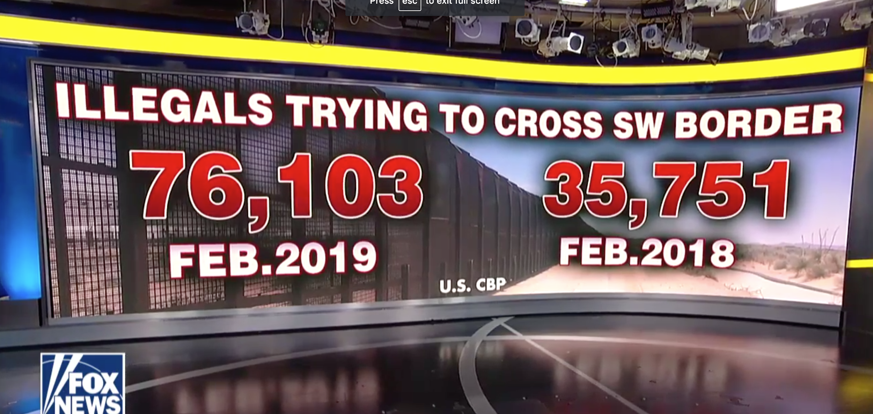
Fox News - Family unit apprehensions at southern border up 300 percent since fiscal year 2018: CBP (Mar. 06, 2019)

Slide 38
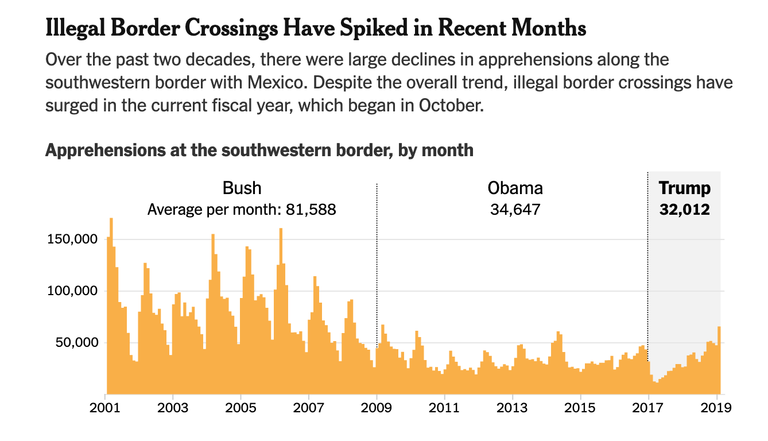
NYT - Border at ‘Breaking Point’ as More than 76,000 Unauthorized Migrants Cross in a Month (3/6/19)

Slide 39
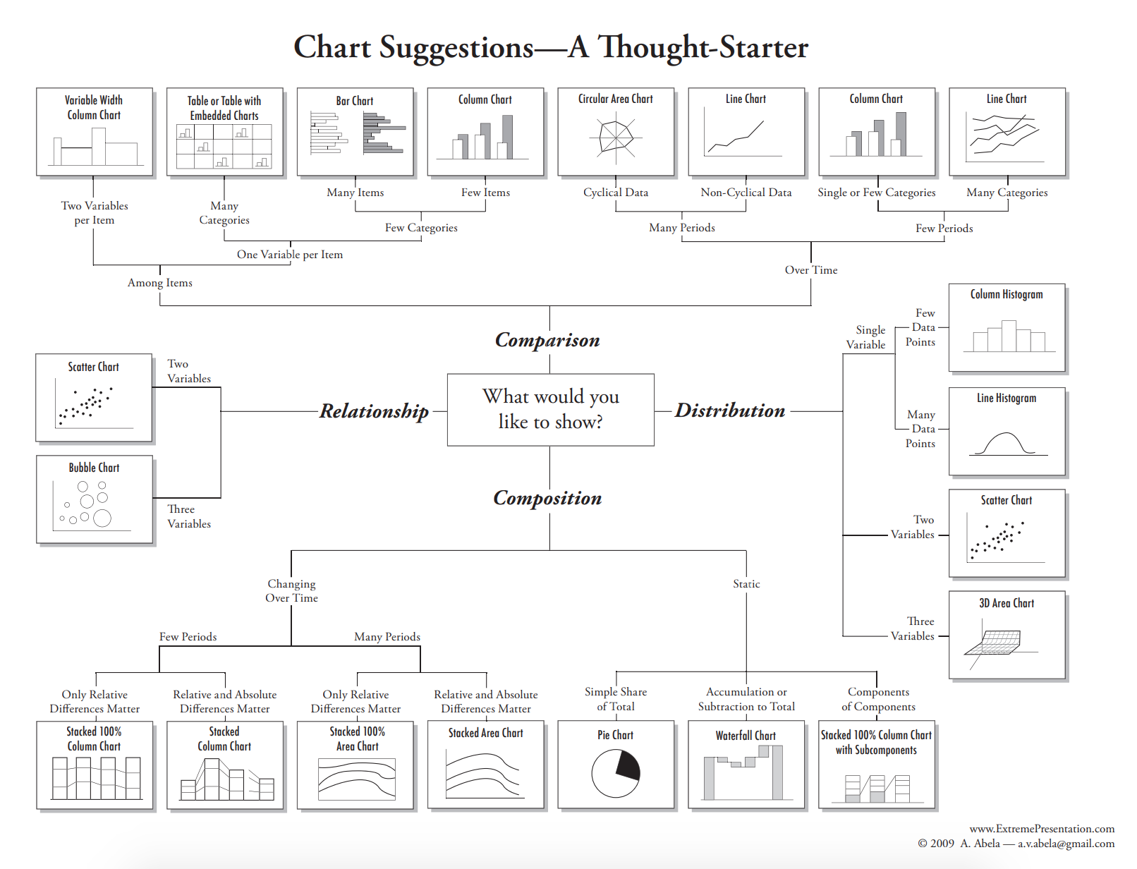

Slide 40
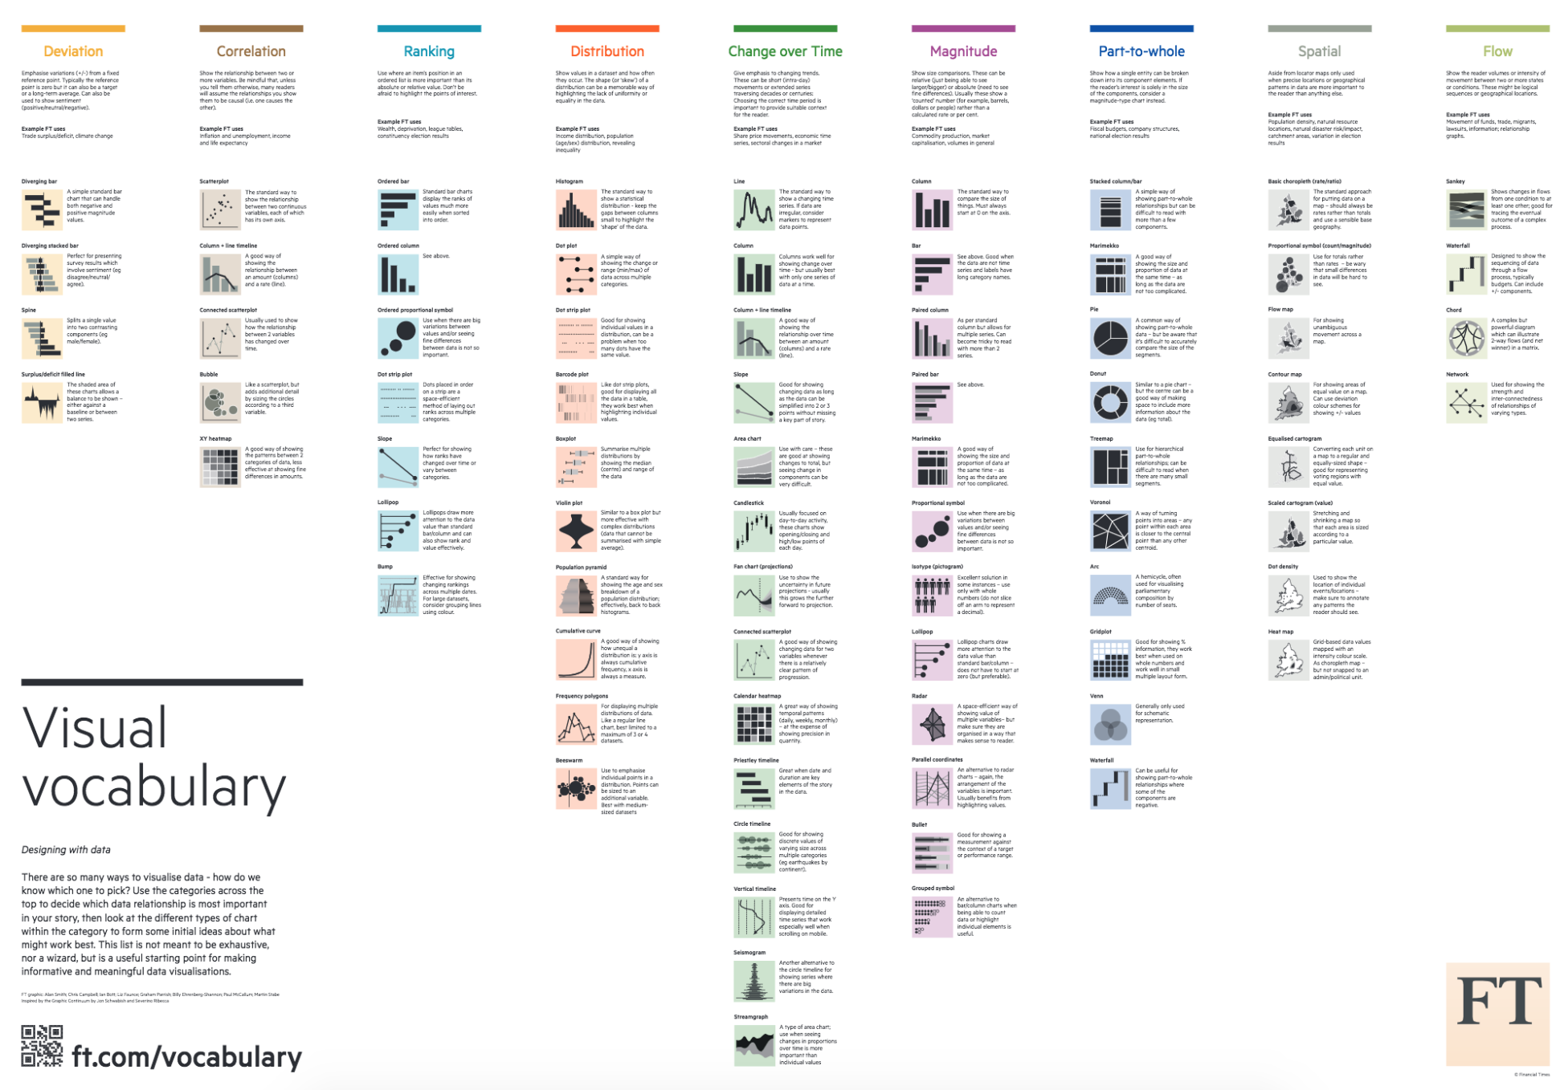
Notes:
https://github.com/ft-interactive/chart-doctor/tree/master/visual-vocabulary

Slide 41
Notes:
https://medium.com/multiple-views-visualization-research-explained/multiple-views-on-how-to-choose-a-visualization-b3ffc99fcddc

